Slide 1
Selenium
Session 12
Grouping in TestNG, Dependencies

Slide 2
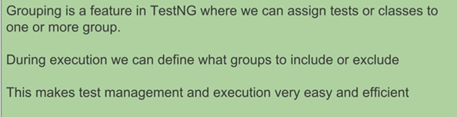
TestNG Grouping
A. What is Grouping

Slide 3
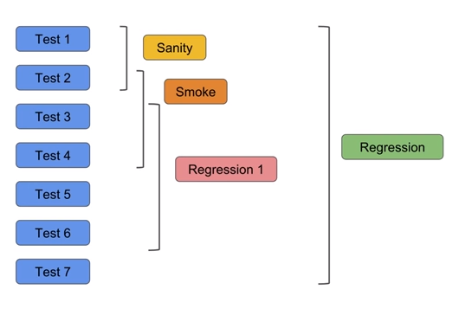
Why to create groups
Suppose there are 7 test and we need to include some test in Sanity, Smoke, Regression 1 and complete regression then in that case we can create groups.

Slide 4
How to Create Test Groups
→ Create one class, add few methods in class, add groups see below example –
package testNG;
import org.testng.annotations.Test;
public class TestNGGroupsDemo {
@Test(groups = {"sanity"})
public void test1() {
System.out.println("This is Test 1");
}
@Test(groups = {"sanity", "smoke"})
public void test2() {
System.out.println("This is Test 2");
}
@Test(groups = {"sanity","regression"})
public void test3() {
System.out.println("This is Test 3");
}

Slide 5
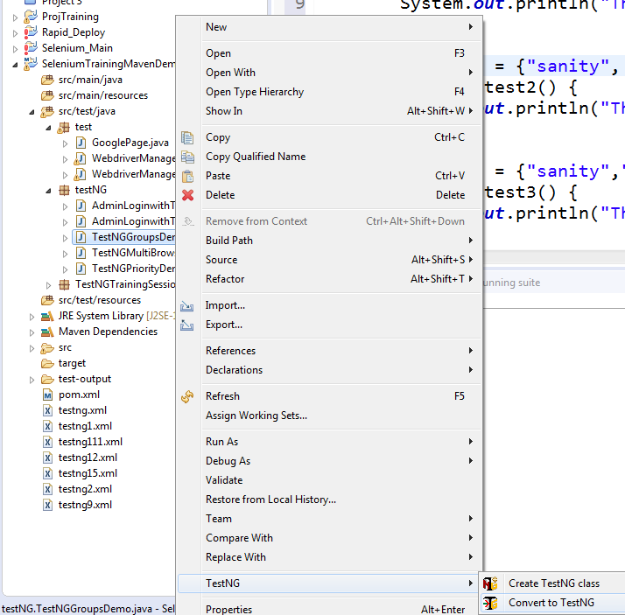
@Test
public void test4() {
System.out.println("This is Test 4");
}
}
Create TestNG.xml –
Right click on class > TestNG > Convert to TestNG

Slide 6
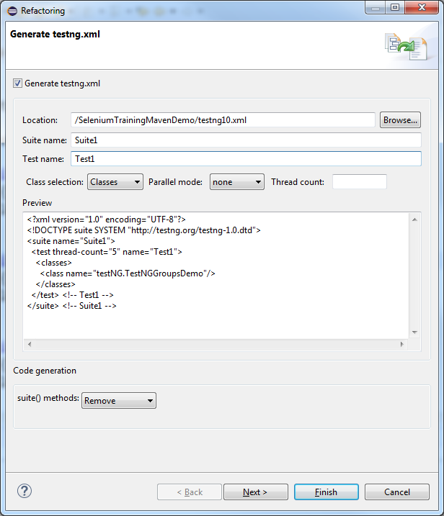
XML →
<?xml version="1.0" encoding="UTF-8"?>
<!DOCTYPE suite SYSTEM "http://testng.org/testng-1.0.dtd">
<suite name="Suite1">
<test thread-count="5" name="Test1">
<classes>
<class name="testNG.TestNGGroupsDemo"/>
</classes>
</test> <!-- Test1 -->
</suite> <!-- Suite1 -->

Slide 7
→ So under test tag we can add groups tags and under groups tag we can add run tag to define what to include and what to exclude
<?xml version="1.0" encoding="UTF-8"?>
<!DOCTYPE suite SYSTEM "http://testng.org/testng-1.0.dtd">
<suite name="Suite1">
<test thread-count="5" name="Test1">
<groups>
<run>
<include name="sanity"></include>
</run>
</groups>
<classes>
<class name="testNG.TestNGGroupsDemo"/>
</classes>
</test> <!-- Test1 -->
</suite> <!-- Suite1 -->
TestNG report will display

Slide 8
Run
In Console will display below log
[RemoteTestNG] detected TestNG version 6.14.3
This is Test 1
This is Test 2
This is Test 3
===============================================
Suite1
Total tests run: 3, Failures: 0, Skips: 0
===============================================

Slide 9
Update xml to
<?xml version="1.0" encoding="UTF-8"?>
<!DOCTYPE suite SYSTEM "http://testng.org/testng-1.0.dtd">
<suite name="Suite1">
<test name="Test1">
<groups>
<run>
<include name="sanity"></include>
<exclude name="regression"></exclude>
</run>
</groups>
<classes>
<class name="testNG.TestNGGroupsDemo"/>
</classes>
</test> <!-- Test1 -->
</suite> <!-- Suite1 -->

Slide 10
Run
In Console will display below log
[RemoteTestNG] detected TestNG version 6.14.3
This is Test 1
This is Test 2
===============================================
Suite1
Total tests run: 2, Failures: 0, Skips: 0
===============================================

Slide 11
How to Create MetaGroups
Under group tag define meta group and add/include groups which are needed then under run tag include metatag
See example of xml below –
<?xml version="1.0" encoding="UTF-8"?>
<!DOCTYPE suite SYSTEM "http://testng.org/testng-1.0.dtd">
<suite name="Suite1">
<test name="Test1">
<groups>
<define name="Regression 1">
<include name="smoke"></include>
<include name="regression"></include>
</define>
<run>
<include name="Regression 1"></include>
</run>
</groups>
<classes>
<class name="testNG.TestNGGroupsDemo"/>
</classes>
</test> <!-- Test1 -->
</suite> <!-- Suite1 -->

Slide 12
Run
In Console will display below log
[RemoteTestNG] detected TestNG version 6.14.3
This is Test 2
This is Test 3
===============================================
Suite1
Total tests run: 2, Failures: 0, Skips: 0
===============================================

Slide 13
How to define groups at class level
Example
package testNG;
import org.testng.annotations.Test;
@Test(groups={"AllClassTest"})
public class TestNGGroupsDemo {
@Test(groups = {"sanity"})
public void test1() {
System.out.println("This is Test 1");
}
@Test(groups = {"sanity", "smoke"})
public void test2() {
System.out.println("This is Test 2");
}
@Test(groups = {"sanity","regression"})
public void test3() {
System.out.println("This is Test 3");
}
@Test
public void test4() {
System.out.println("This is Test 4");
}
}

Slide 14
XML
<?xml version="1.0" encoding="UTF-8"?>
<!DOCTYPE suite SYSTEM "http://testng.org/testng-1.0.dtd">
<suite name="Suite1">
<test name="Test1">
<groups>
<run>
<include name="AllClassTest"></include>
</run>
</groups>
<classes>
<class name="testNG.TestNGGroupsDemo"/>
</classes>
</test> <!-- Test1 -->
</suite> <!-- Suite1 -->

Slide 15
Run
In Console will display below log
[RemoteTestNG] detected TestNG version 6.14.3
This is Test 1
This is Test 2
This is Test 3
This is Test 4
===============================================
Suite1
Total tests run: 4, Failures: 0, Skips: 0
===============================================

Slide 16
How to Create Dependencies
→ Example 1
package testNG;
import org.testng.annotations.Test;
public class TestNGDependencyDemo {
@Test (dependsOnMethods = {"test2"})
public void test1() {
System.out.println("I am inside Test 1");
}
@Test
public void test2() {
System.out.println("I am inside Test 2");
}
}

Slide 17
Run the class as TestNG Test
In Console will display below log
[RemoteTestNG] detected TestNG version 6.14.3
I am inside Test 2
I am inside Test 1
PASSED: test2
PASSED: test1
===============================================
Default test
Tests run: 2, Failures: 0, Skips: 0
===============================================

Slide 18
Dependencies Scenario – When tests have priority set
→ Example 2
package testNG;
import org.testng.annotations.Test;
public class TestNGDependencyDemo {
@Test (dependsOnMethods = {"test2"},priority=1)
public void test1() {
System.out.println("I am inside Test 1");
}
@Test (priority=2)
public void test2() {
System.out.println("I am inside Test 2");
}
}

Slide 19
Run the class as TestNG Test
In Console will display below log
[RemoteTestNG] detected TestNG version 6.14.3
I am inside Test 2
I am inside Test 1
PASSED: test2
PASSED: test1
===============================================
Default test
Tests run: 2, Failures: 0, Skips: 0
===============================================
Note - Even if priority is set, dependency will take preference

Slide 20
How to create dependencies on multiple tests
→ Example 3
package testNG;
import org.testng.annotations.Test;
public class TestNGDependencyDemo {
@Test (dependsOnMethods = {"test2", "test3"})
public void test1() {
System.out.println("I am inside Test 1");
}
@Test
public void test2() {
System.out.println("I am inside Test 2");
}
@Test
public void test3() {
System.out.println("I am inside Test 3");
}
}

Slide 21
Run the class as TestNG Test
In Console will display below log
[RemoteTestNG] detected TestNG version 6.14.3
I am inside Test 2
I am inside Test 3
I am inside Test 1
PASSED: test2
PASSED: test3
PASSED: test1
===============================================
Default test
Tests run: 3, Failures: 0, Skips: 0
===============================================

Slide 22
How to create group dependencies
→ Example 4
package testNG;
import org.testng.annotations.Test;
public class TestNGDependencyDemo {
@Test (dependsOnGroups={"smoke"})
public void test1() {
System.out.println("I am inside Test 1");
}
@Test (groups={"smoke"})
public void test2() {
System.out.println("I am inside Test 2");
}
@Test
public void test3() {
System.out.println("I am inside Test 3");
}
}

Slide 23
Run the class as TestNG Test
In Console will display below log
[RemoteTestNG] detected TestNG version 6.14.3
I am inside Test 2
I am inside Test 3
I am inside Test 1
PASSED: test2
PASSED: test3
PASSED: test1
===============================================
Default test
Tests run: 3, Failures: 0, Skips: 0
===============================================

Slide 24
Using regular expression
→ Example 5
package testNG;
import org.testng.annotations.Test;
public class TestNGDependencyDemo {
@Test (dependsOnGroups={"smoke.*"})
public void test1() {
System.out.println("I am inside Test 1");
}
@Test (groups={"smoke1"})
public void test2() {
System.out.println("I am inside Test 2");
}
@Test (groups={"smoke2"})
public void test3() {
System.out.println("I am inside Test 3");
}
}

Slide 25
Run the class as TestNG Test
In Console will display below log
[RemoteTestNG] detected TestNG version 6.14.3
I am inside Test 2
I am inside Test 3
I am inside Test 1
PASSED: test2
PASSED: test3
PASSED: test1
===============================================
Default test
Tests run: 3, Failures: 0, Skips: 0
===============================================

